Slide 1
COS 781 (Data Mining)
Theme 5
Data Clustering

Slide 2
Overview
What is clustering?
Components of clustering algorithms
Pattern representation
Similarity measures
Clustering algorithms
Assessment of clusters
Applications of clustering

Slide 3
What is Clustering?
Organisation of patterns into groups
Unsupervised
Patterns in each group have two properties
They are highly similar in some way
They and different from patterns in any other group

Slide 4
What is Clustering?

Slide 5
Components of Clustering Algorithms
Clustering algorithms require
Pattern representation
Similarity measure
A clustering algorithm
Assessment of clusters

Slide 6
Pattern Representation
Some data preparation is usually necessary
How many patterns should be used?
Should we use all features, or only some?
Features are used to determine cluster membership
We also need to consider the curse of dimensionality
Feature selection: Choose a subset of features
Feature extraction: Create a new, smaller, set of features
Which data types are represented?
Some algorithms only work with certain data types
Do we need to specify the number of clusters?

Slide 7
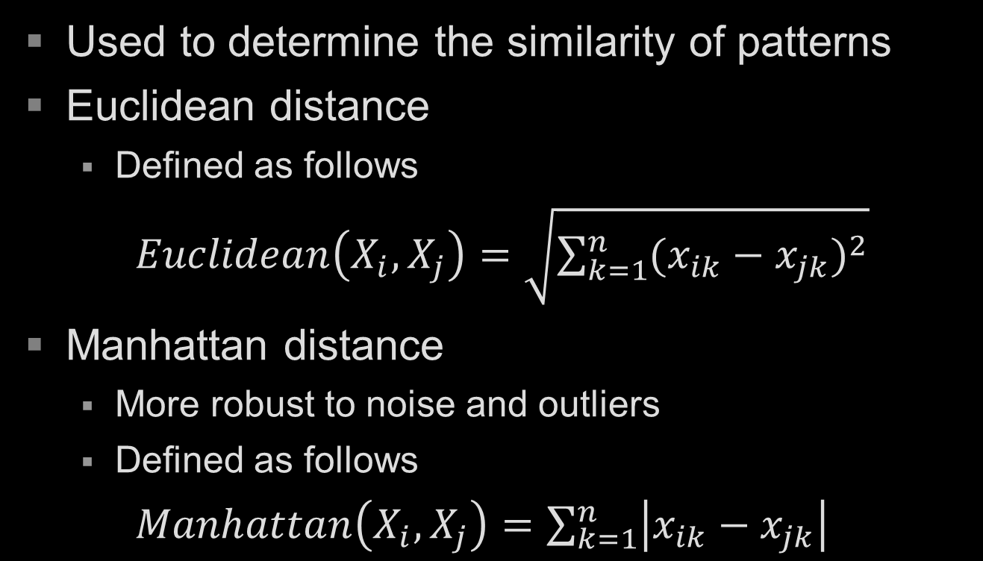
Similarity Measures
Used to determine the similarity of patterns
Euclidean distance
Defined as follows
$Euclidean\left(X_{i},X_{j}\right)=\sqrt{\sum_{k=1}^{n}{{(x_{ik}−x_{jk})}^{2}}}$
Manhattan distance
More robust to noise and outliers
Defined as follows
$Manhattan\left(X_{i},X_{j}\right)=\sum_{k=1}^{n}{\left|x_{ik}−x_{jk}\right|}$

Slide 8
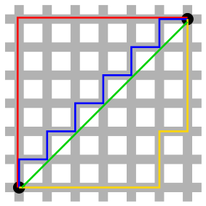
Similarity Measures
Green line: Euclidean distance
Other lines: Manhattan distance

Slide 9
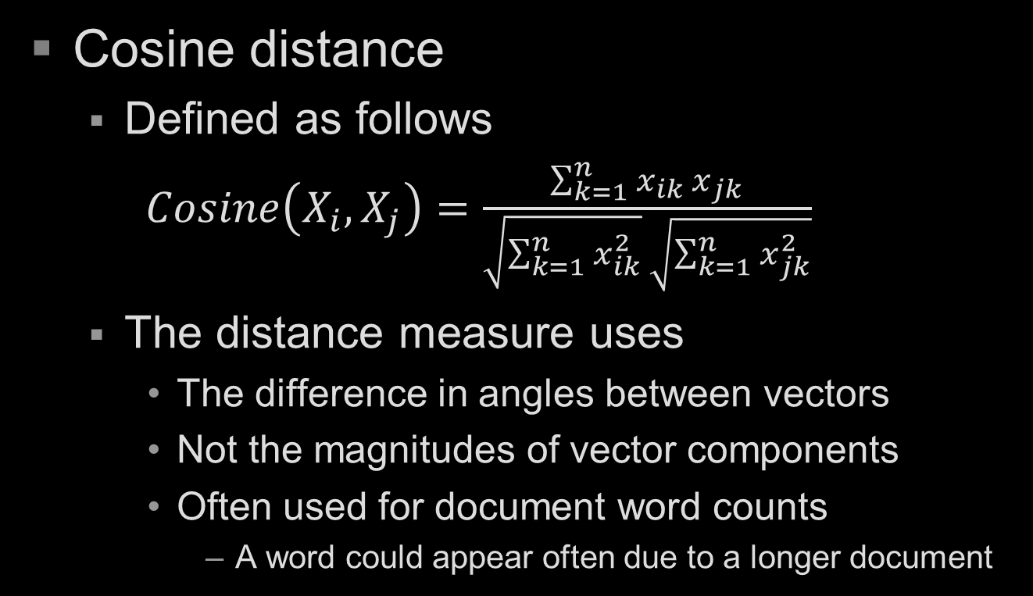
Distance Measures
Cosine distance
Defined as follows
$Cosine\left(X_{i},X_{j}\right)=\frac{\sum_{k=1}^{n}{x_{ik} x_{jk}}}{\sqrt{\sum_{k=1}^{n}{x_{ik}^{2}}} \sqrt{\sum_{k=1}^{n}{x_{jk}^{2}}}}$
The distance measure uses
The difference in angles between vectors
Not the magnitudes of vector components
Often used for document word counts
A word could appear often due to a longer document

Slide 10
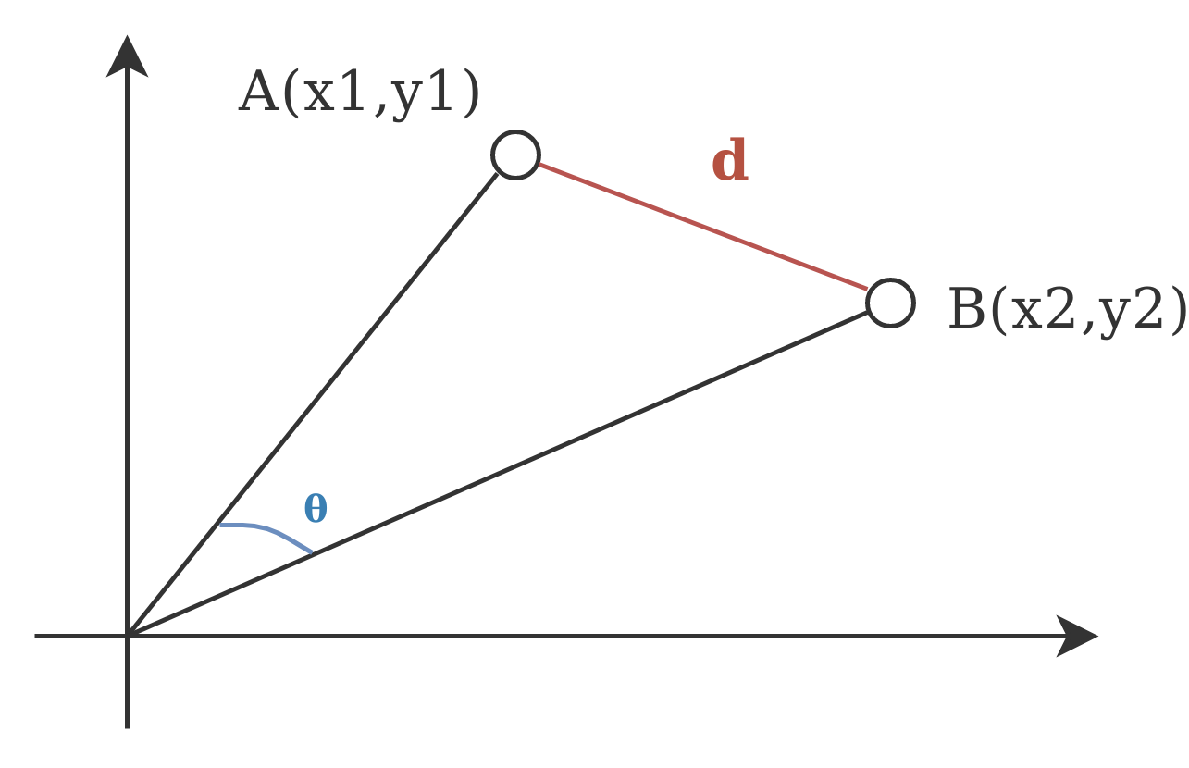

Distance Measures
$d$: Euclidean distance
$θ$: Cosine distance

Slide 11
Distance Measures
For all these measures
Patterns must be numeric
How would we handle non-numeric values?
Scaling of vector components is critical
We’ve discussed this before
Centroids
A representative vector for a cluster
Usually a vector where components are the average of all cluster member patterns

Slide 12
Clustering Algorithms
Hierarchical clustering algorithms
Construct a tree of clusters
Usually referred to ass a dendrogram
Dendrograms can be “cut” in different ways
Static
Patterns don’t move between clusters
What about overlapping clusters?
Computationally expensive

Slide 13
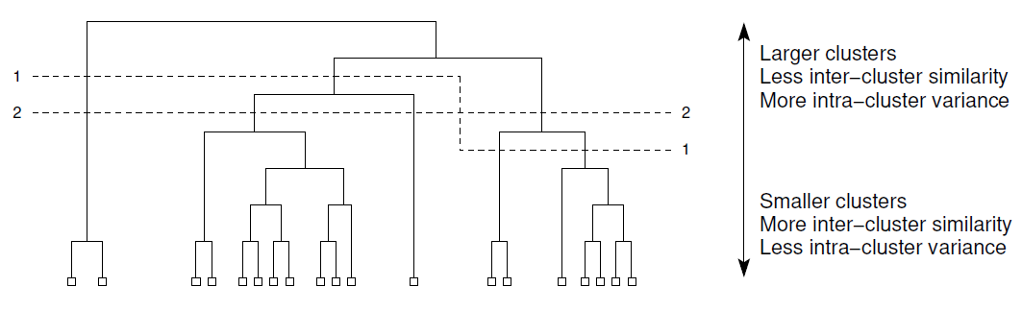
Clustering Algorithms
Two different “cuts” of a dendrogram that produce four clusters

Slide 14
Clustering Algorithms
Hierarchical clustering algorithms
Two types
Agglomerative
Start with each pattern in its own cluster
Merge 2 clusters with closest centroids
Stop when only one cluster exists
Divisive
Start with all patterns in the same cluster
Select a cluster and split it
Stop when each pattern is in its own cluster

Slide 15
Clustering Algorithms
Partitional clustering algorithms
Number of clusters must be specified
A heuristic is necessary
Defines how “good” the clustering is
Based on inter- and intra-cluster differences
Algorithm minimises the heuristic

Slide 16
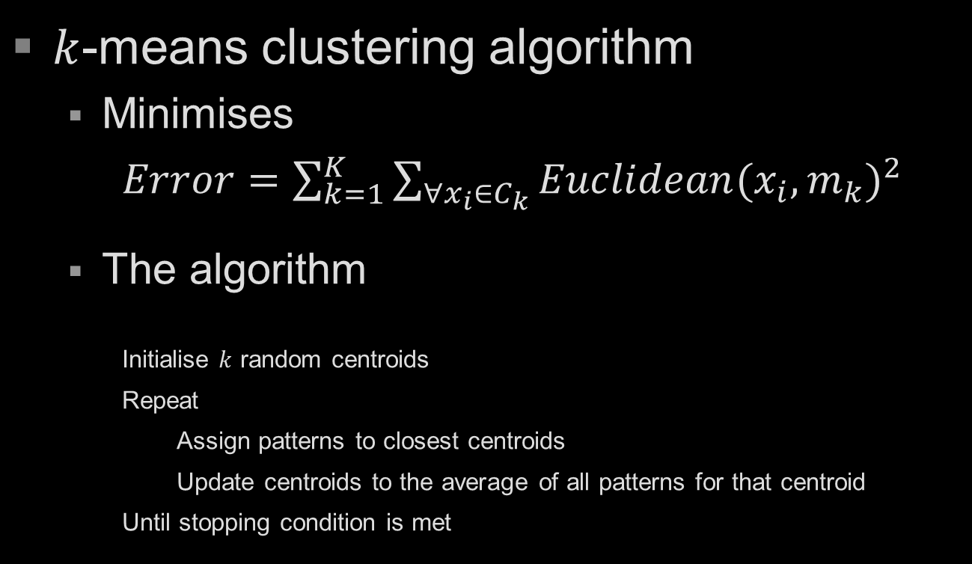
Clustering Algorithms
$k$-means clustering algorithm
Minimises
$Error=\sum_{k=1}^{K}{\sum_{∀x_{i}∈C_{k}}{Euclidean{{(x}_{i},m_{k})}^{2}}}$
The algorithm
Initialise $k$ random centroids
Repeat
Assign patterns to closest centroids
Update centroids to the average of all patterns for that centroid
Until stopping condition is met

Slide 17
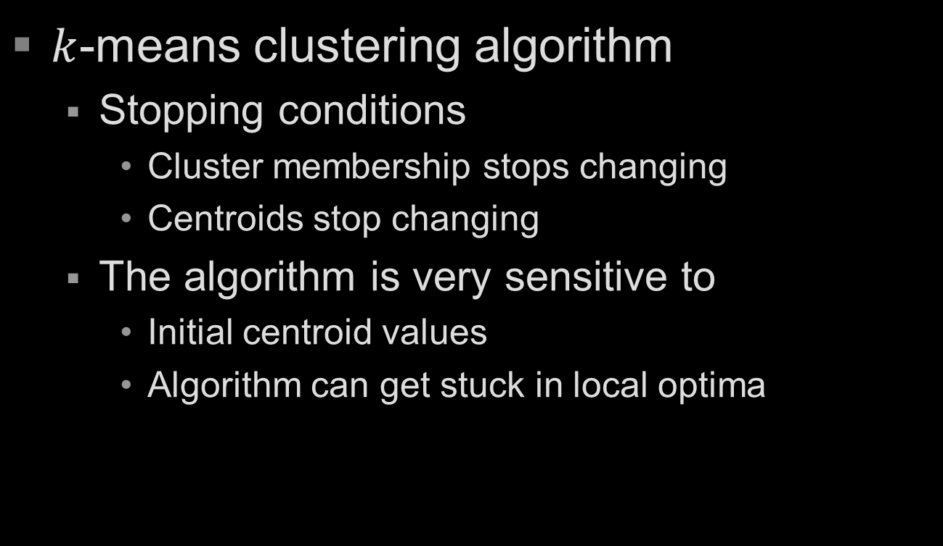
Clustering Algorithms
$k$-means clustering algorithm
Stopping conditions
Cluster membership stops changing
Centroids stop changing
The algorithm is very sensitive to
Initial centroid values
Algorithm can get stuck in local optima

Slide 18
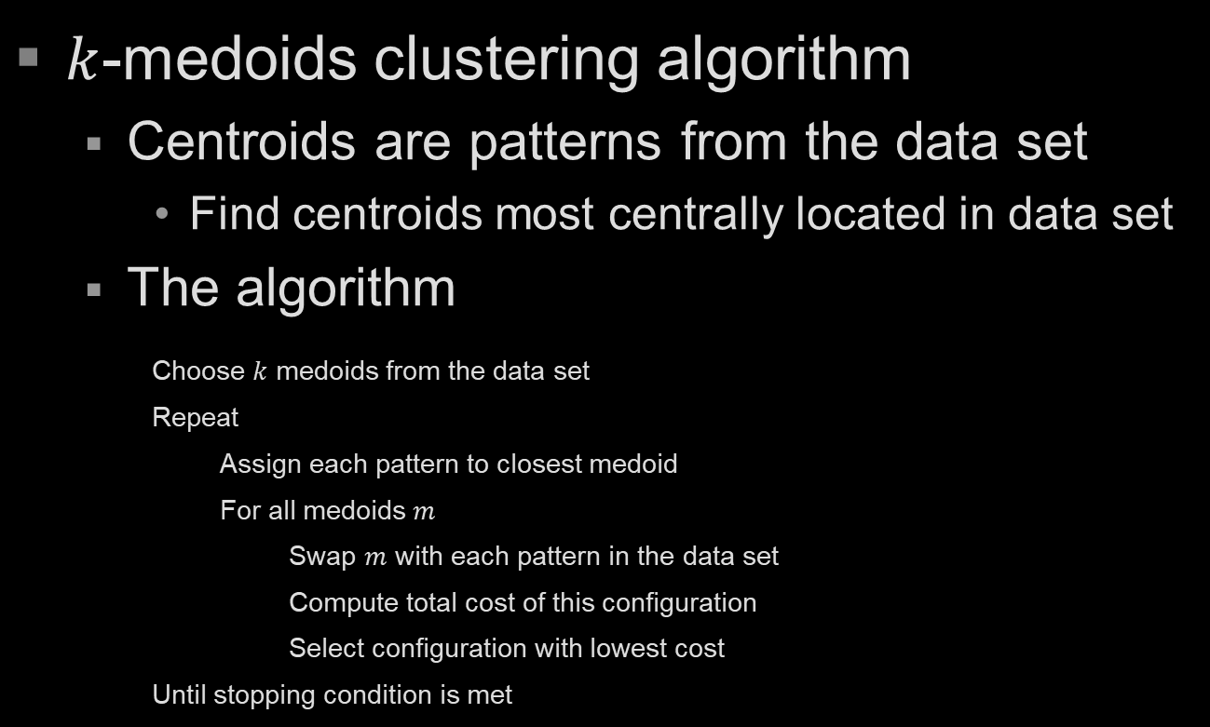
Clustering Algorithms
$k$-medoids clustering algorithm
Centroids are patterns from the data set
Find centroids most centrally located in data set
The algorithm
Choose $k$ medoids from the data set
Repeat
Assign each pattern to closest medoid
For all medoids $m$
Swap $m$ with each pattern in the data set
Compute total cost of this configuration
Select configuration with lowest cost
Until stopping condition is met

Slide 19
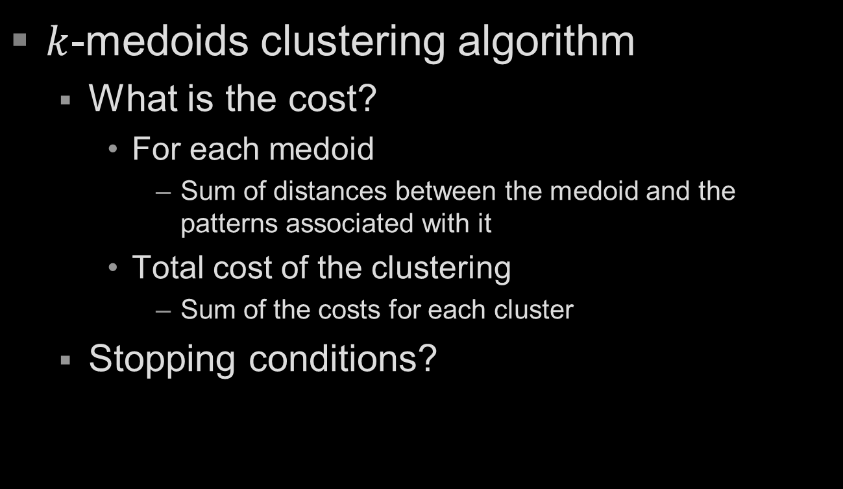
Clustering Algorithms
$k$-medoids clustering algorithm
What is the cost?
For each medoid
Sum of distances between the medoid and the patterns associated with it
Total cost of the clustering
Sum of the costs for each cluster
Stopping conditions?

Slide 20
Clustering Algorithms
Incremental clustering
Number of clusters determined by algorithm
The algorithm
Assign first pattern to the only cluster
For all remaining patterns
Assign pattern to an existing cluster
OR create a new cluster and assign the pattern to it

Slide 21
Cluster Quality
We want clusters to be homogeneous
If clusters are not homogeneous enough, more clusters are required
Cluster quality measures often use
Inter cluster distance
Minimum distance between two centroids
Intra cluster distance
Average of distances between all patterns in the cluster and the cluster centroid

Slide 22
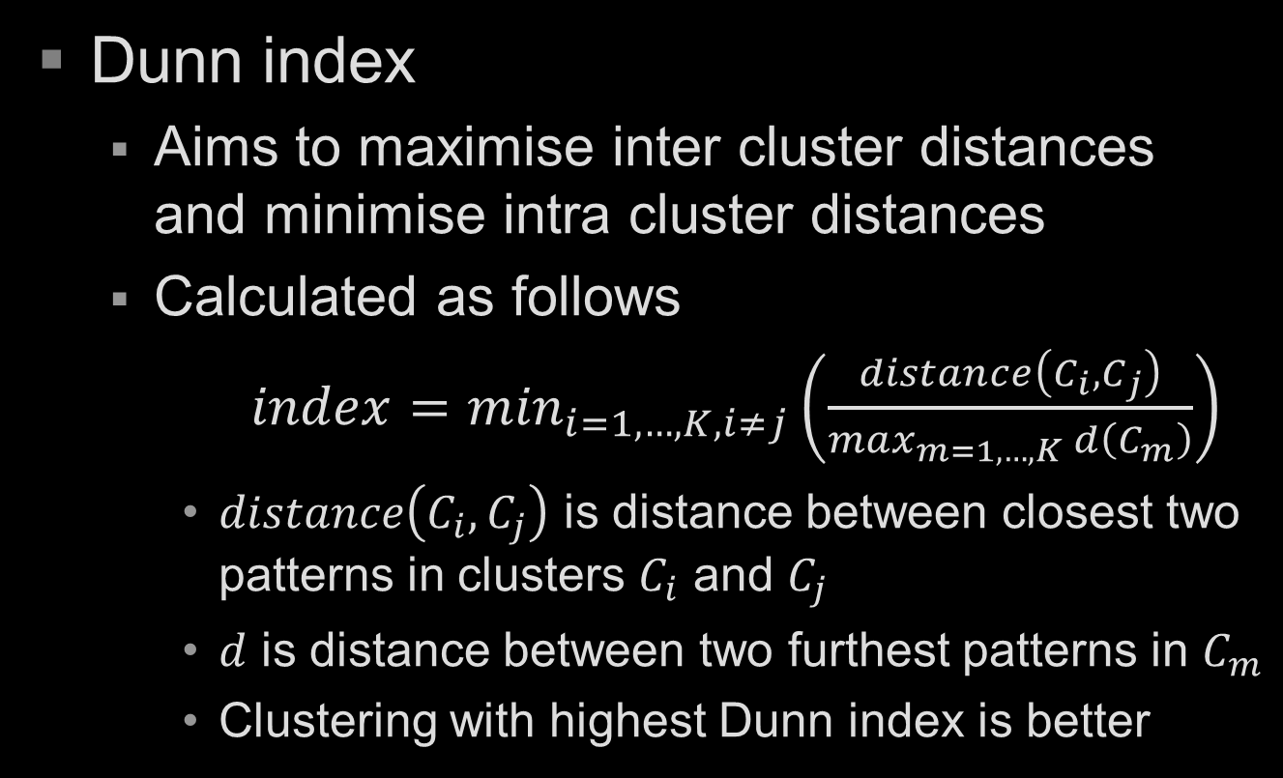
Cluster Quality
Dunn index
Aims to maximise inter cluster distances and minimise intra cluster distances
Calculated as follows
$index=\min_{i=1,…,K,i≠j}\left(\frac{distance\left(C_{i},C_{j}\right)}{\max_{m=1,…,K} d\left(C_{m}\right)}\right)$
$distance\left(C_{i},C_{j}\right)$ is distance between closest two patterns in clusters $C_{i}$ and $C_{j}$
$d$ is distance between two furthest patterns in $C_{m}$
Clustering with highest Dunn index is better

Slide 23
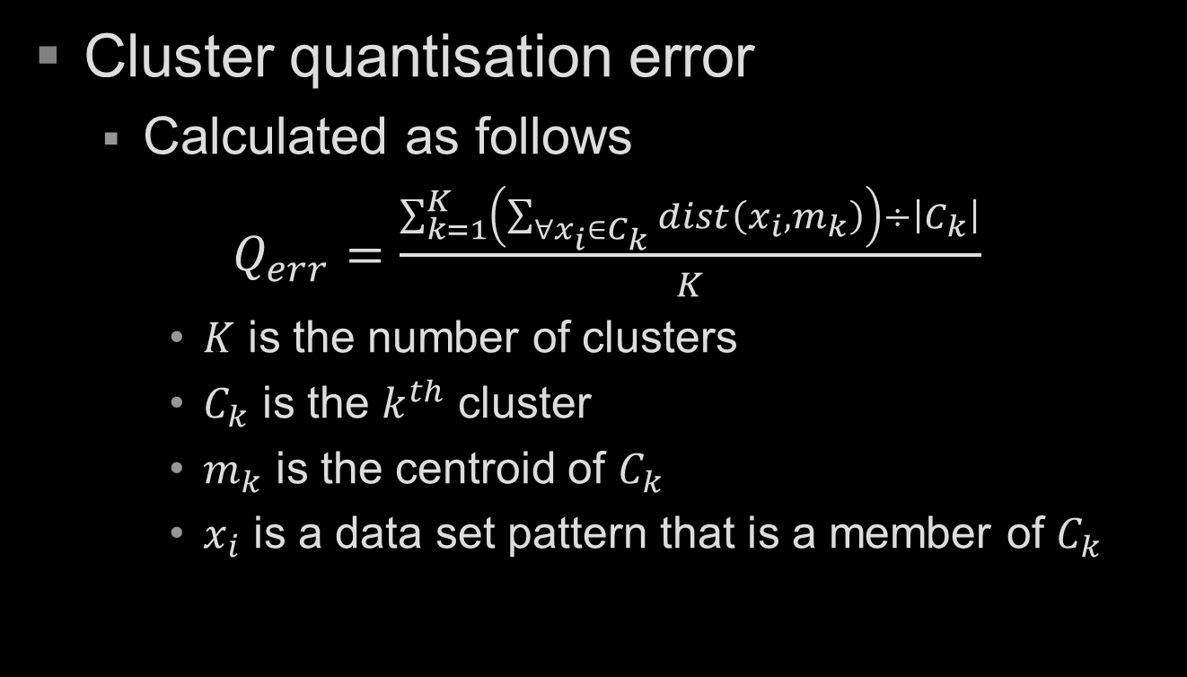
Cluster Quality
Cluster quantisation error
Calculated as follows
$Q_{err}=\frac{\sum_{k=1}^{K}{\left(\sum_{∀x_{i}∈C_{k}}{dist\left(x_{i},m_{k}\right)}\right)}÷\left|C_{k}\right|}{K}$
$K$ is the number of clusters
$C_{k}$ is the $k^{th}$ cluster
$m_{k}$ is the centroid of $C_{k}$
$x_{i}$ is a data set pattern that is a member of $C_{k}$

Slide 24
General Stopping Conditions
Several stopping conditions are possible
When centroids stop changing
When cluster membership stops changing
When satisfactory quality metric is achieved
Maximum number of iterations reached
What else?

Slide 25
Applications of Clustering
Clustering is widely applicable
Classification
Pattern recognition (e.g. speech analysis)
Identifying outliers
Document clustering
Image analysis (e.g. characters, faces, medical)
Profiling (e.g. criminals)
Data set reduction (can do stratified sampling)
Exploratory data analysis

